Slide 1
A new era in healthcare assessment is on the horizon…
Innovation Initiative

Slide 2

Main objectives of Presentation
Build from TennCare Episodes of Care, to Care of the Future
Accountability tool
Graphic depiction
Design PCMH as Central as a Sphere of observation and influence
Patient centered

Slide 3
Secondary Objectives
Visual depiction of healthcare relationships
Introduce Multilevel Framework
Counterfactuals
  What is it?
  Why do we need it?
Model building... Framework for Data

Slide 4
HCn3D System
Tame the “BeaST”
  B Business (Interoperability, business goals)
  S Semantics (Reflects language of network entities)
  T Technology (Quantitation tools)
  e Promote Efficiency
  a Ambiguity resolved by Transparency
Builds on existing technologies
Enhancement by visualization of relationships

Slide 5
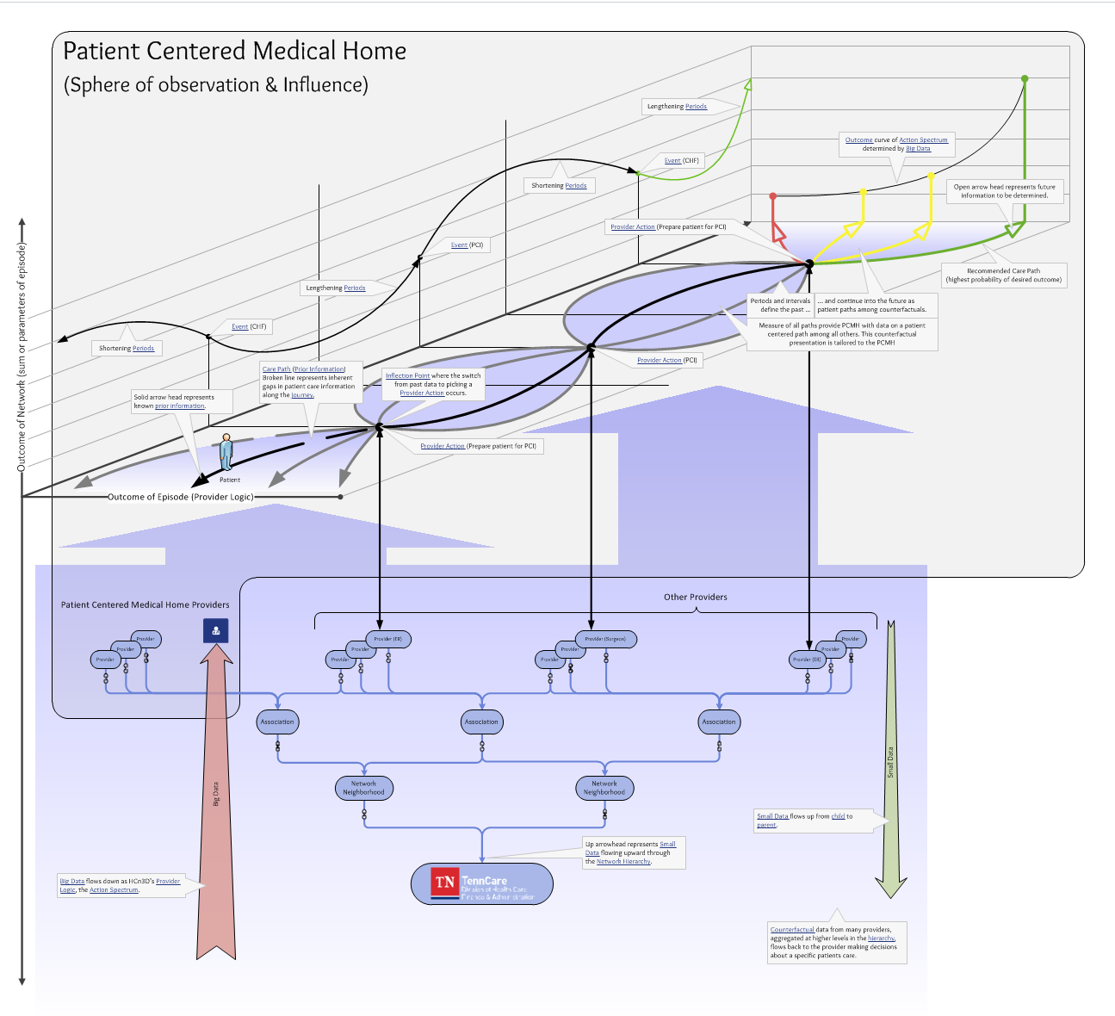
Master HCn3D Graphic

Slide 6
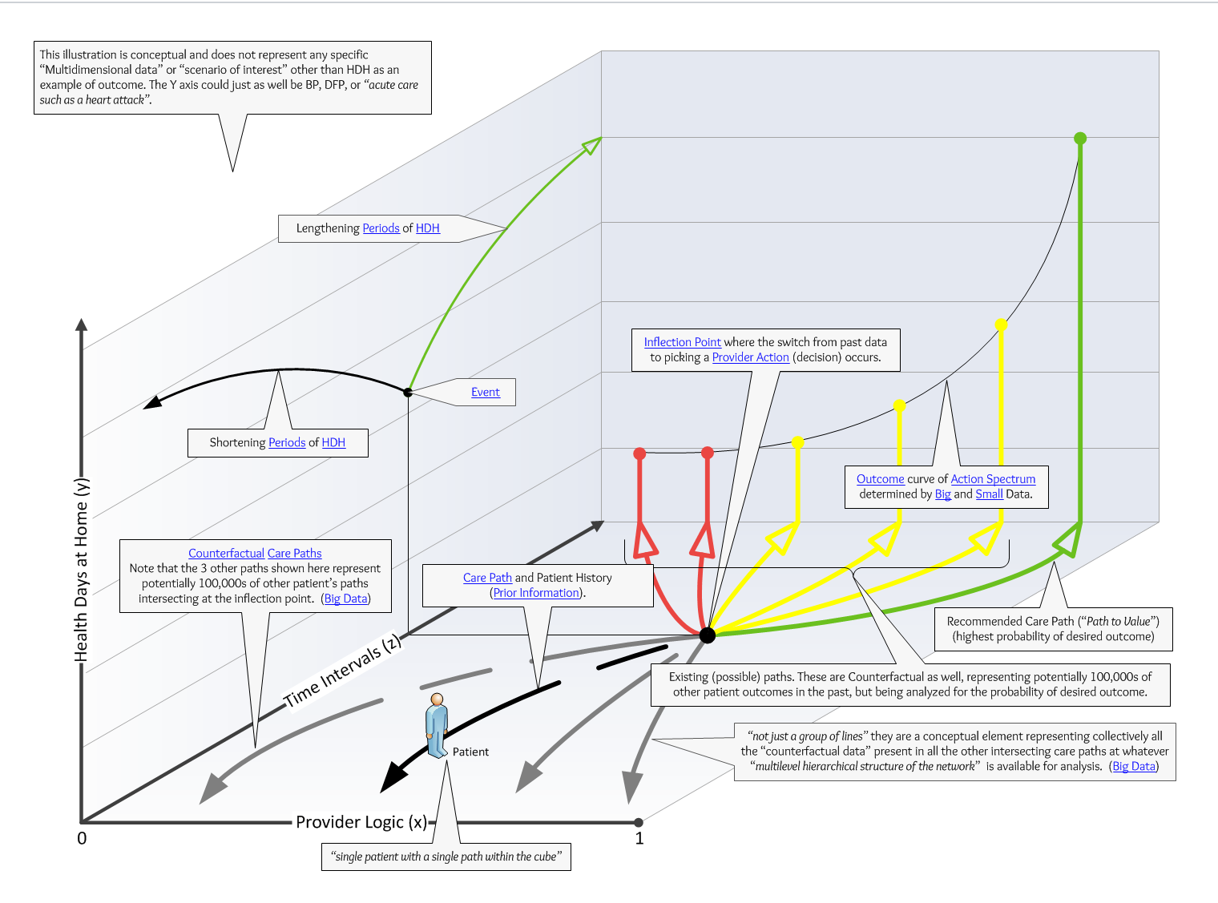
Logic – 1st Dimension

Slide 7
Episode

Slide 8
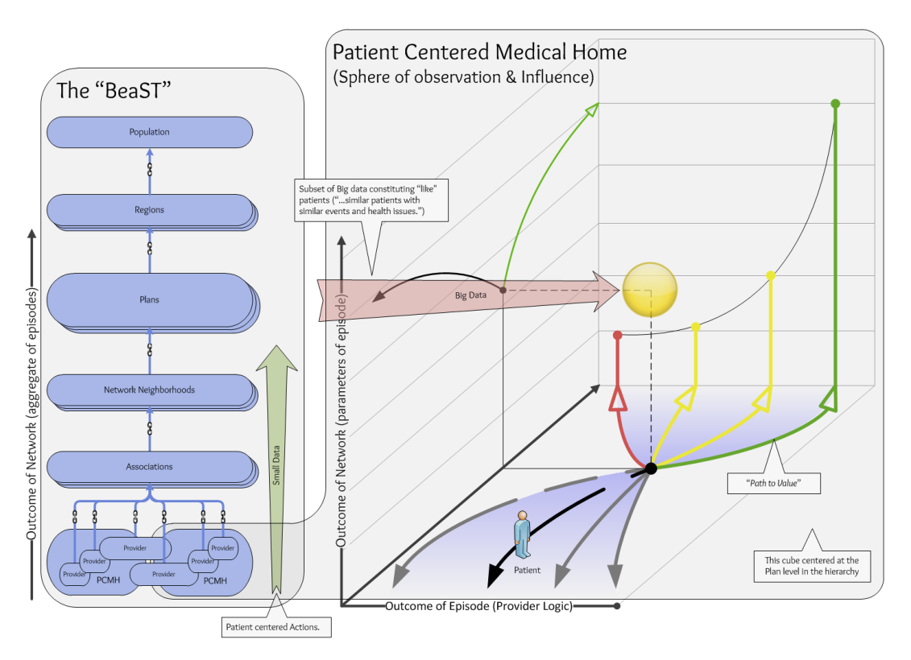
Network – 2nd Dimension
Multilevel Structure
Patient Centered
  Technical meaning
Provider
Provider Associations
  ACO
  PCMH
  informal data driven
Plans
Regional Scale
Network Entities and Links dynamically assembled to define populations

Slide 9
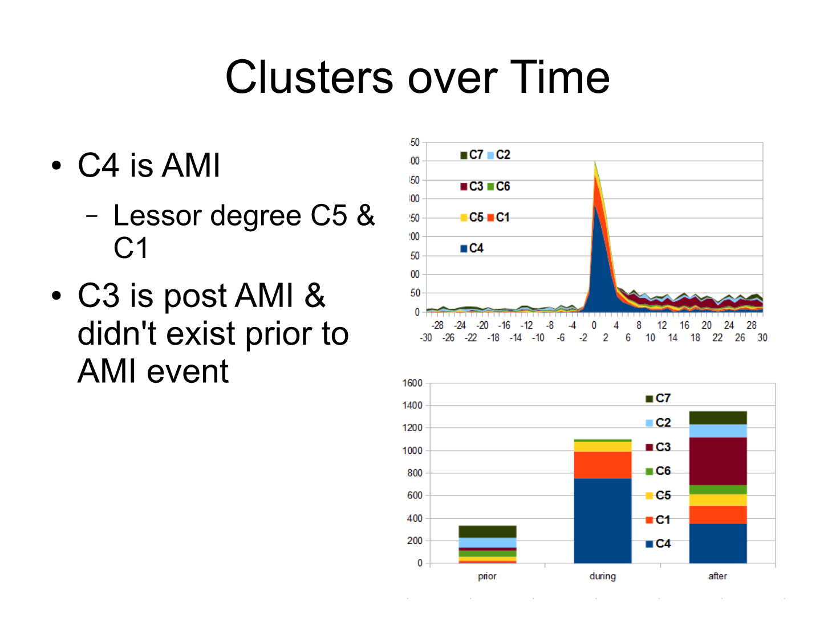
IOC

Slide 10
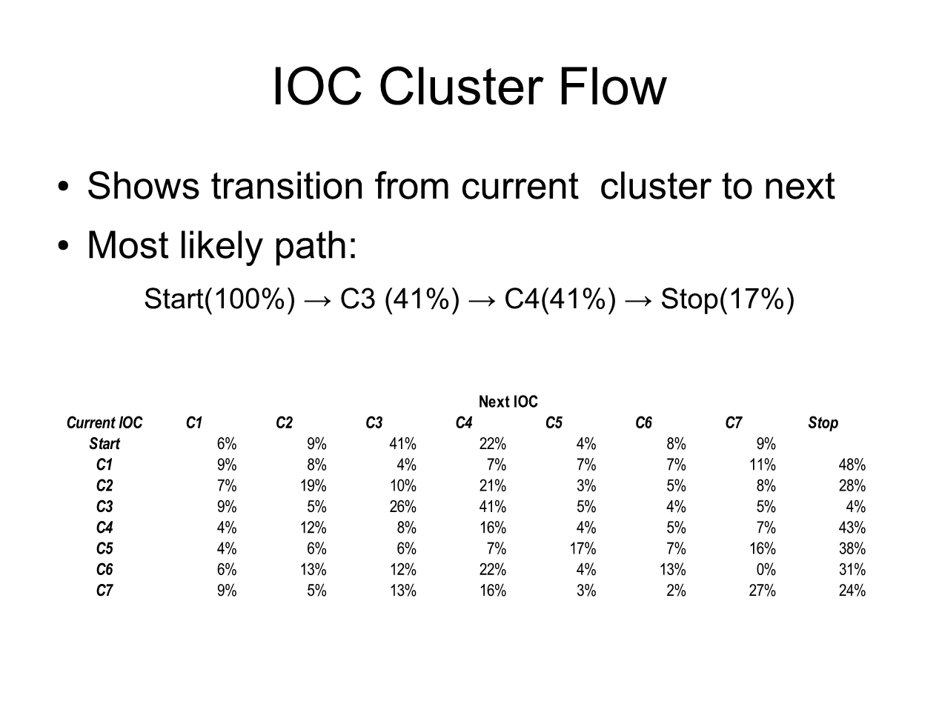
IOC (Continued)

Slide 11
Value Third Dimension

Slide 12
Accountability… A Method
Numerator/Denominator = Value
Numerator = services of care
Denominator = population function of multilevel network
How HCn3D supports building N/D
Dynamic Population Builder

Slide 13
First define the Time interval
Episode of Care
Establish the interval
Instance of care
Broader interval
Future Value Outcomes
Pathways clinical
Trajectory statistical/basis of counterfactuals

Slide 14
Once Interval decided, define Numerator
Episodes of Care
  Sum services that are triggered
Instances of Care
  Broader time duration surrounding Trigger
  Broader impact on multilevel network
Future Value Outcomes
  Intervals and Periods
  Extended intervals of pathway/trajectories

Slide 15
Once Interval decided, Define Denominator
Defined by the population
Episode of Care
  PCI summed for Provider
  All PCI groups all Providers
  Providers patient base for PCI service defines population for benchmark
Instance of Care (Patient defined)
Future Value Outcomes of Network/Subnetwork
  Dynamic Population Builder for “at risk” group that contributes to Healthy Days at Home metric
  Support for Counterfactual Outcomes such as Potentially Preventable ER visits, avoidable CHF episodes

Slide 16
Future Value Outcomes
CMS objective of outcomes measures replacing process measures by 2018
MedPac 2014 Chapter 3
  Rudimentary outcomes discussion
MedPac 2015 Chapter 8
  Struggle to define time boundaries for health days at home
CMS Metric for Outcomes
  Primarily Counterfactual objectives – measure what did not happen
  Potentially Preventable ER visits, Surgeries, HDAH
Tenncare Opportunity to build from Episode technology to CMS Outcome Objectives

Slide 17
Value of the Inflection Point
Point in Time
Assembles input and output of Logic
Linkages within paths
Journey of Episodes
  Grouped by Time Intervals for IOC
  Trajectory to Future Value Outcomes
Reflected in Networks/Subnetworks
HCn3D Deliverable to PCMH
Many faces of Accountability

Slide 18
Framework for Individualizing Predictors of Disease¹
The equation
The model
The trajectory

Slide 19
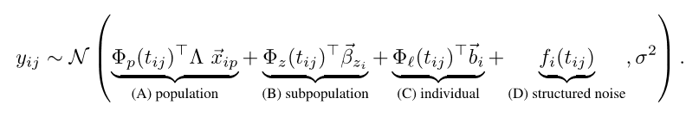
The Equation¹

Slide 20
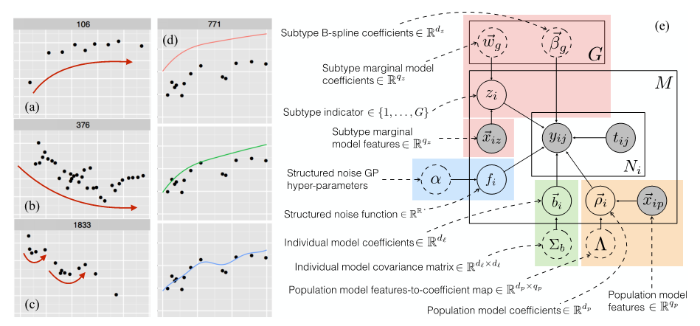
The Model¹

Slide 21
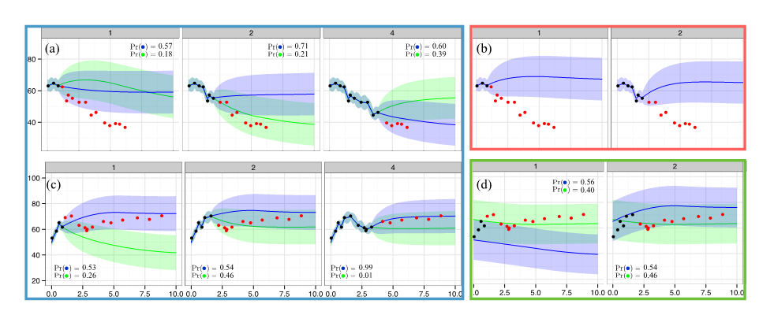
The Trajectory¹

Slide 22
Healthy Days at Home (HDAH)

Slide 23
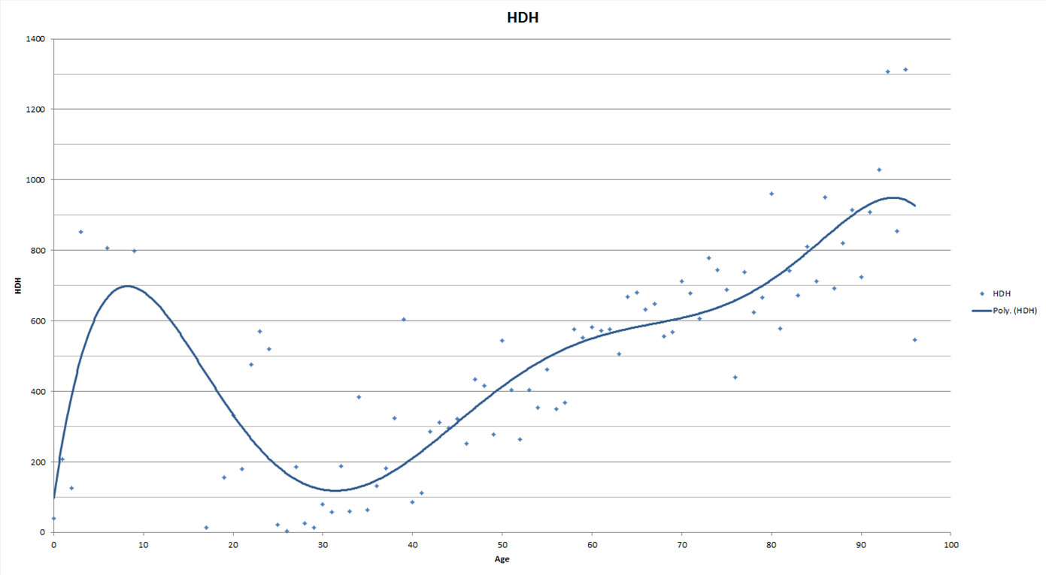
Healthy Days at Home (cont.)

Slide 24
Role of PCMH
Sphere of observation
Sphere of influence

Slide 25
PCMH Sphere of Observation
Network
  Coordination
  Collaboration
Subnetworks
  Centered on Patient
  PCMH determined population for Accountability
Episodes, IOC, Value
Journey/Trajectory

Slide 26
PCMH Sphere of Influence
Network Policies
Impact Decision at Inflection Point
Network Distribution of Logic
Action possibilities for Future Value
  Subnetwork “small data”
  Deterministic (not probabilistic) actionable at patient level

Slide 27
Various Technologies of 3 Dimensions
Data generation
Aggregation
Probabilities
Counterfactuals

Slide 28
Care Coordination and Collaboration
Within Network Aggregation
Future Value Outcomes

Slide 29
References
Schulam P, Saria S. A Framework for Individualizing Predictions of Disease Trajectories by Exploiting Multi-Resolution Structure. http://pschulam.com/papers/schulam+saria_nips_2015.pdf.

Slide 30
Resources/Contact
Website: http://hcn3d.com/
Email: rcripley@ripleyandassociates.com
Phone: 615.347.8363

